Slide 1
IST 659 Final Project Parking Database Management
BY-
Pralhad R Vaishnav
Rahul Kotian
Shrey Sheth
Syed Naqvi
Prof. Jillian K Lando

Slide 2
Overview
This Project focuses on developing a database for managing the vehicle parking’s.
It includes various parking places in Syracuse University and allows to organize them.
With this Project, we can track various types of Vehicles check in and out, their customer information, based on the usage information of charges and parking employee’s information.

Slide 3
Goals
The main objective is to create a database for Parking Management System to continuously monitor an area to ease life of people including parking vehicle users and the company who owns the parking places in Syracuse, by:
Manage the records of vehicles, taking entry and exit time.
Stream the Revenues by bringing transparency to operations, which will help to improve efficiency. Additionally, allow better monitoring of employee’s performance• Improve security, by keeping track of vehicles in the system
With UI interactions employees can see this database through an app which will display vehicle details, passholder information and the availability of the spaces

Slide 4
Specifications
Entity Relationship Data Requirements/Business Rules
Conceptual Data Model
Logical Data Model
SQL/Up/Down Script to create/drop tables, keys constraints*
User Stories
External data model satisfying user stories
User Interface Design

Slide 5
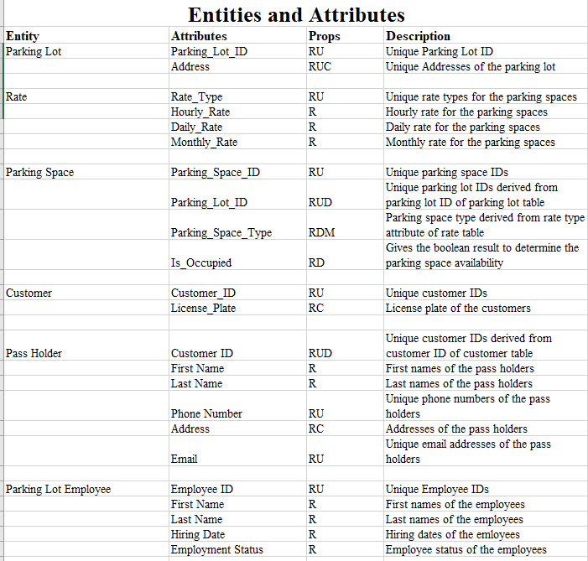
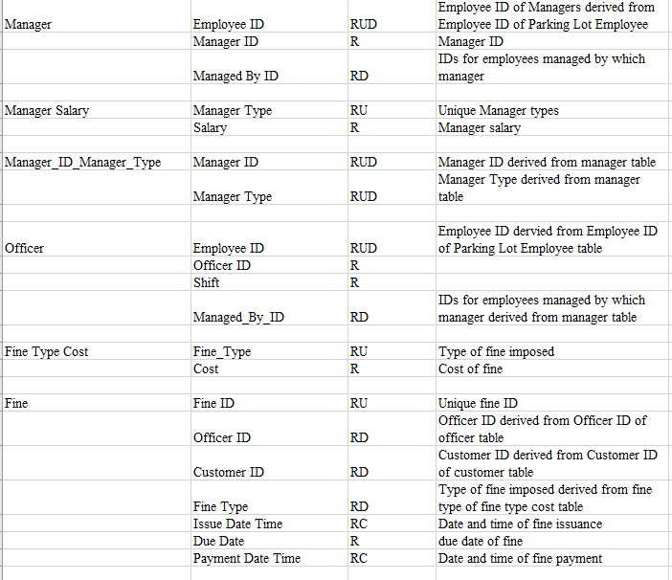
ERD Data Requirements

Slide 6
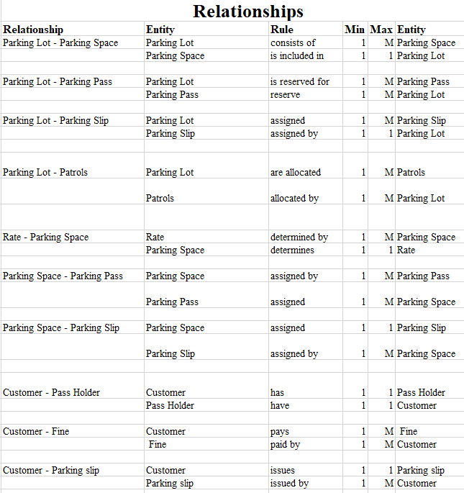
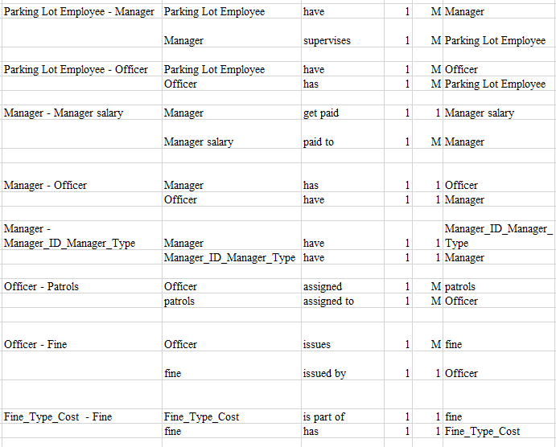
ERD Data Requirements

Slide 7
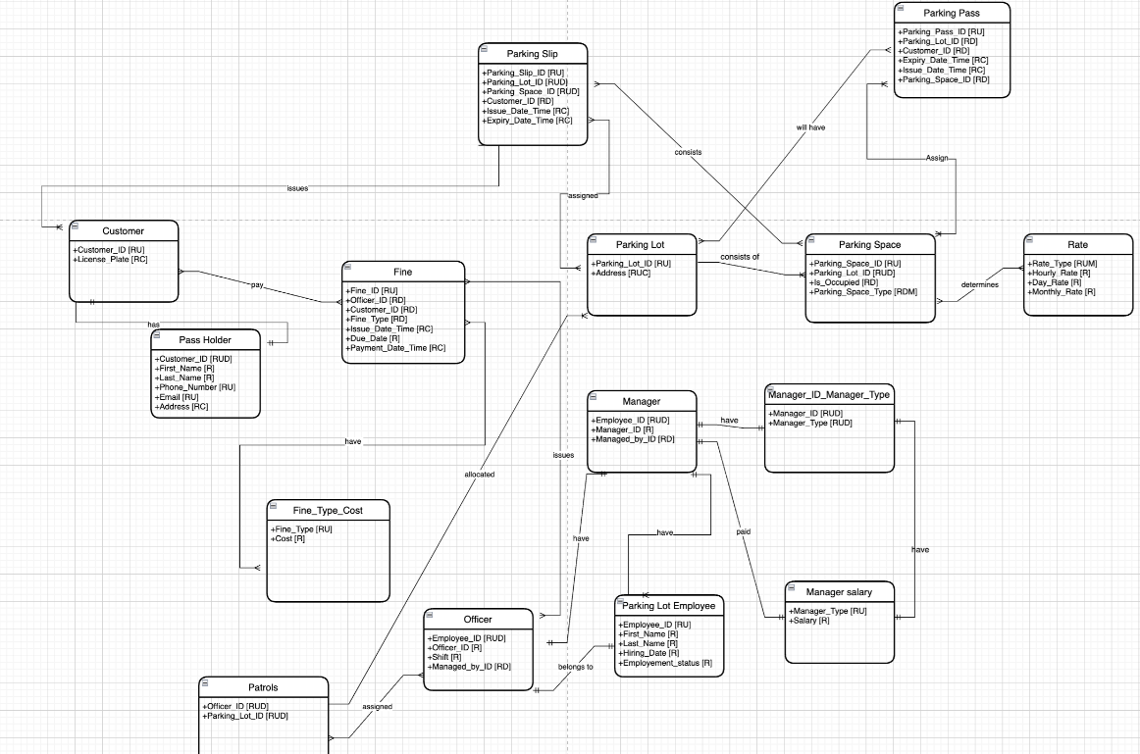
Conceptual Model

Slide 8
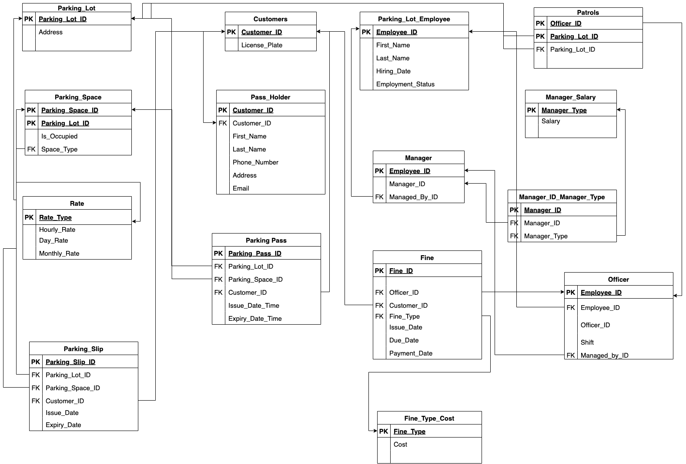
Logical Model

Slide 9
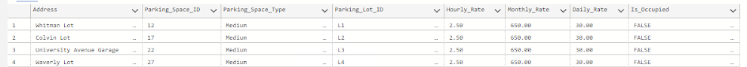
As a user, I would like to find parking space near Syracuse University with parking space of my car type with rates
SELECT l.Address,ps.Parking_Space_ID, ps.Parking_Space_Type, ps.Parking_Lot_ID,r.Hourly_Rate,r.Monthly_Rate, r.Daily_Rate,ps.Is_Occupied FROM Parking_Space ps
INNER JOIN Rate r
ON ps.Parking_Space_Type = r.Rate_Type
LEFT JOIN Parking_Lot l
on l.Parking_Lot_ID =ps.Parking_Lot_ID
where ps.Parking_Space_Type ='Medium’ AND ps.Is_Occupied = 'FALSE’

Slide 10
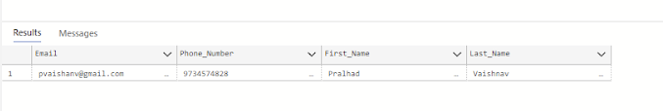
As a user, I would like to find the customer details whose pass is due expiry in less than a month
select Email, Phone_Number,First_Name,Last_Name from Pass_Holder ph
INNER JOIN Parking_Pass pp
ON ph.Customer_ID = pp.Customer_ID
WHERE pp.Expiry_Date_Time = '2022-12-31 23:59:59'

Slide 11
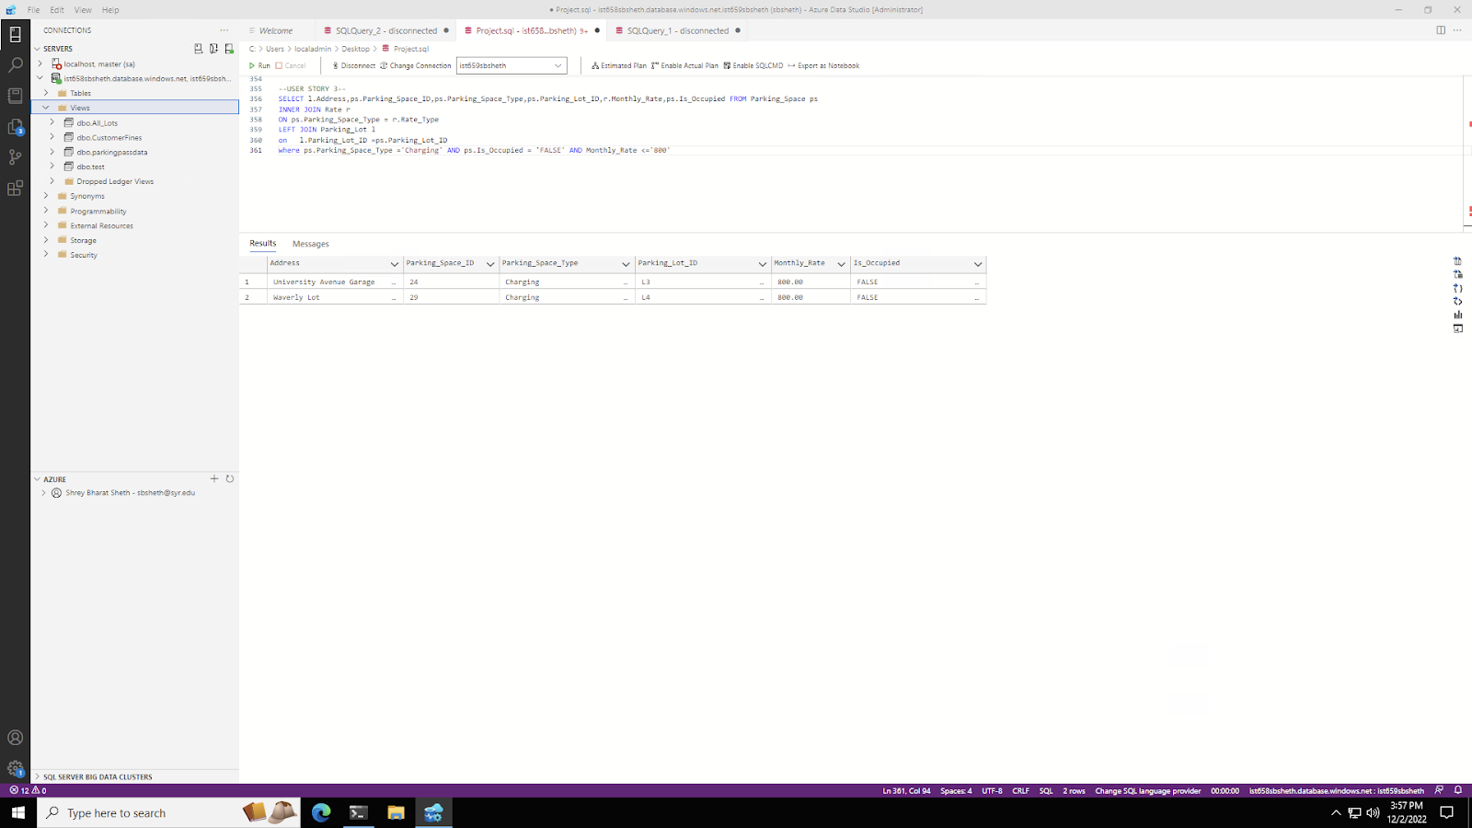
As a user, I would like to find parking space with charging point and with monthly rate less than 800
SELECT l.Address,ps.Parking_Space_ID,ps.Parking_Space_Type,ps.Parking_Lot_ID,r.Monthly_Rate,ps.Is_Occupied FROM Parking_Space ps
INNER JOIN Rate r
ON ps.Parking_Space_Type = r.Rate_Type
LEFT JOIN Parking_Lot l
on l.Parking_Lot_ID =ps.Parking_Lot_ID
where ps.Parking_Space_Type ='Charging' AND ps.Is_Occupied = 'FALSE' AND Monthly_Rate <='800'

Slide 12
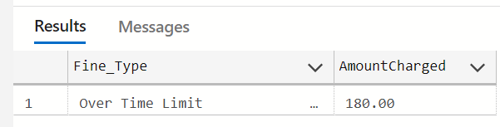
As a user, I would like to know based on selected fine type, how much total amount has been associated
drop FUNCTION if EXISTS f_finetype
GO
CREATE FUNCTION f_finetype (@Fine_Type varchar (50))
RETURNS TABLE
as
RETURN
(
SELECT f.Fine_Type,sum(fc.Cost) AS AmountCharged from Fine f
INNER JOIN Fine_Type_Cost fc
ON f.Fine_Type = fc.Fine_Type
WHERE
f.Fine_Type = @Fine_type
GROUP BY f.Fine_Type
);
GO
SELECT * from f_Finetype ('Over Time Limit')

Slide 13
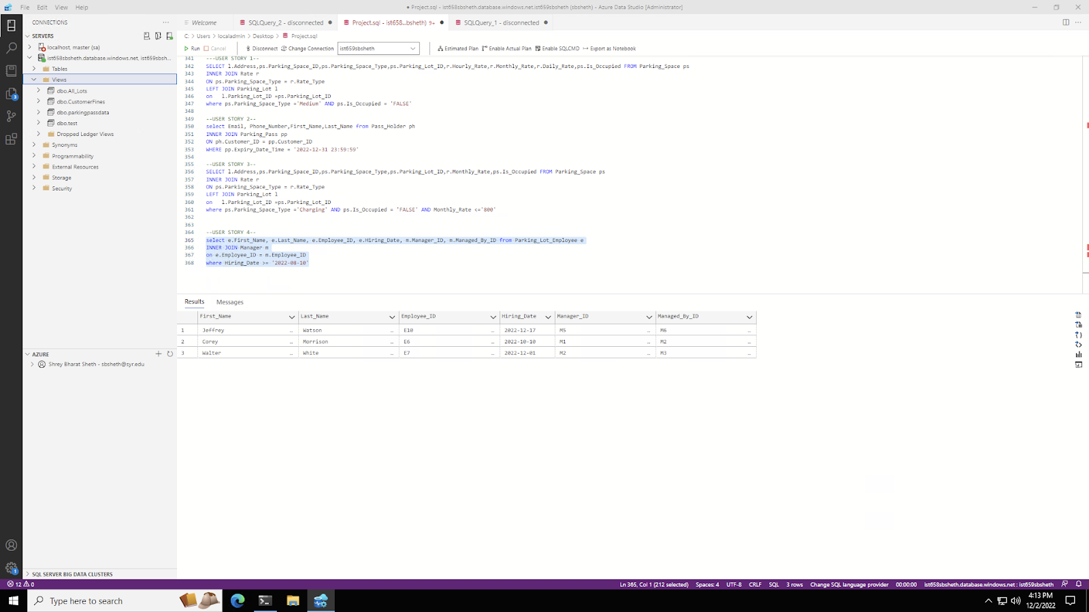
As a user, I would like to the parking employees who are hired after a certain date
select e.First_Name, e.Last_Name, e.Employee_ID, e.Hiring_Date, m.Manager_ID, m.Managed_By_ID from Parking_Lot_Employee e
INNER JOIN Manager m
on e.Employee_ID = m.Employee_ID
where Hiring_Date >= '2022-08-10'

Slide 14
APP DEMO

Slide 15

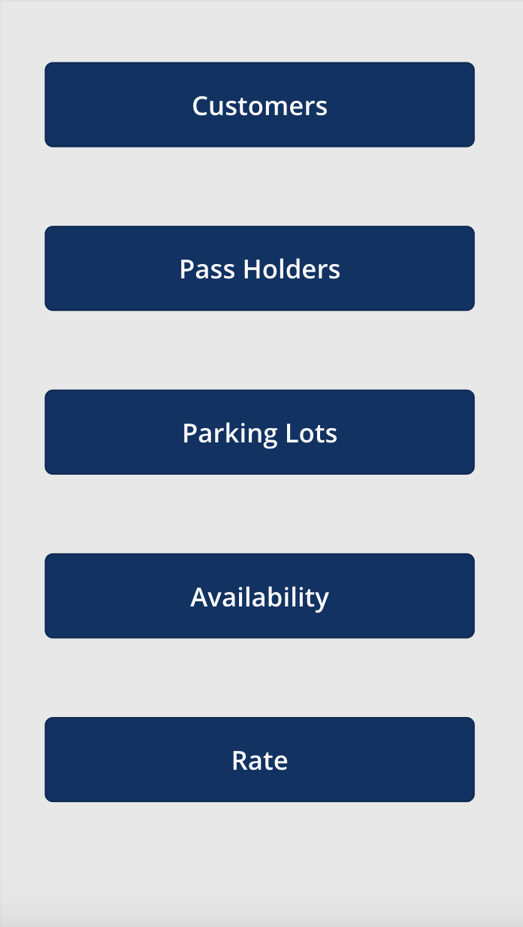
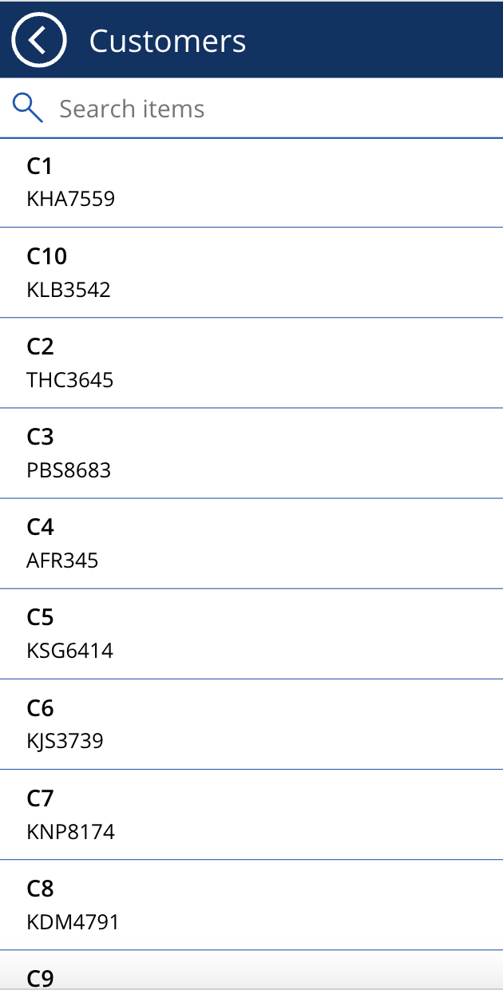
Logical Design of UI Layout

Slide 16
THANK YOU

